Slide 1

AER-1216H FUNDAMENTALS OF UAS PROJECT
PRAKRITI SAINI
RUTVIK SOLANKI
SIVA SUBRAMANIAN VADAKKANTHARA SIVARAMAKRISHNAN
GROUP U

Slide 2
PROJECT MISSION
To design and develop UAS for two types of configuration:
1. Fixed-Wing sUAS configuration (Aerosonde UAV)
2. Multi-rotor Drone development (Quadrotor)

Slide 3
FIXED-WING sUAS DEVELOPMENT
To develop a Fixed-wing UAS system (Design & Analysis) and perform the following:
1. Estimate the sUAS flight range and endurance
2. Develop the fixed-wing dynamics model
3. Develop the altitude/speed control system
4. Develop the Matlab/Simulink (linear) simulation model
5. Conduct simulations, perform data collection and analysis of the vehicle performing the following maneuvers in sequence:
(a) steady level flight for 1000 m at an altitude of 2000 m above sea level
(b) 180◦ coordinated turn with a radius of curvature of 250 m
(c) descend to steady level flight at an altitude of 1000 m above sea level.

Slide 4
MULTI-ROTOR UAS DEVELOPMENT
To develop a quadrotor UAS system (Design & Analysis) and perform the following:
1. Estimate the sUAS flight range and endurance
2. Develop the quadrotor dynamics model
3. Develop the position/orientation control system with state estimation
4. Develop the Matlab/Simulink (linear) simulation model
5. Conduct simulations, perform data collection and analysis of the vehicle performing the following maneuvers in sequence:
(a) take off and hover at 2 meters above origin
(b) fly to the first target (x = 5 m, y = 6 m, h = 4 m) and hover
(c) fly to the second target (x = -5 m, y = -6 m, h = 4 m) and hover
(d) return to 2 meters above origin and land

Slide 5
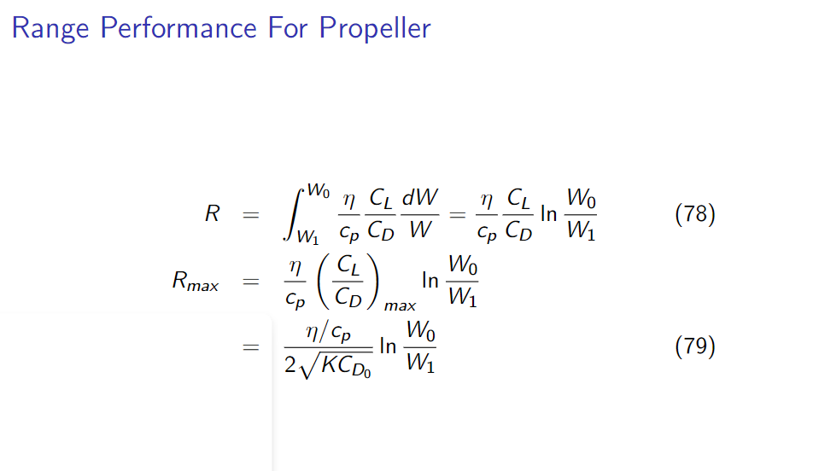
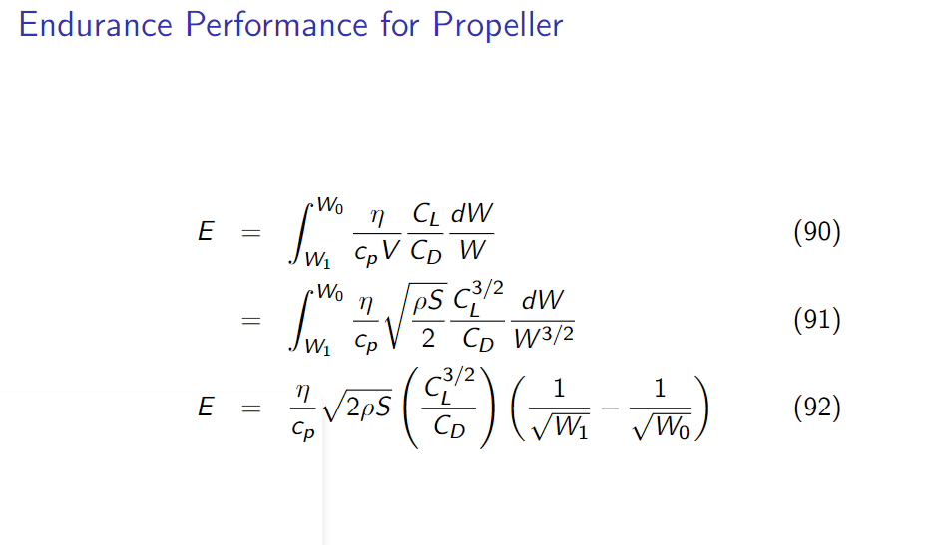
FIXED-WING sUAS DEVELOPMENT
RANGE
Max. Range = 379.04 kms
Formula Used:
ENDURANCE
Max. Endurance = 5.44 hours
Formula Used:
Source: Lecture Notes, Chap-6, AER 1216 – Fundamentals of UAVs

Slide 6
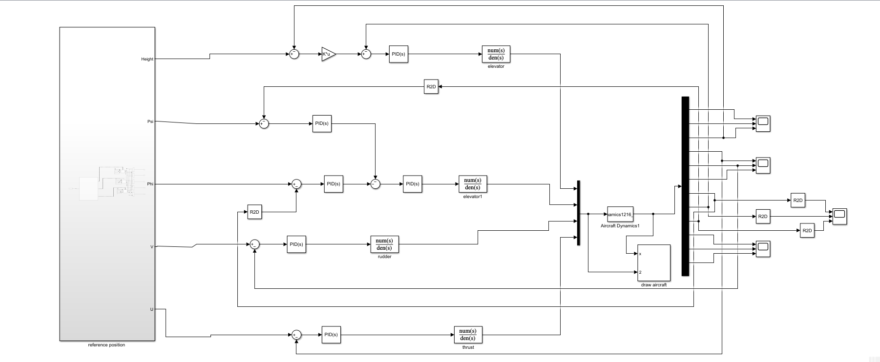
FIXED-WING sUAS DEVELOPMENT
DYNAMICS MODEL:

Slide 7
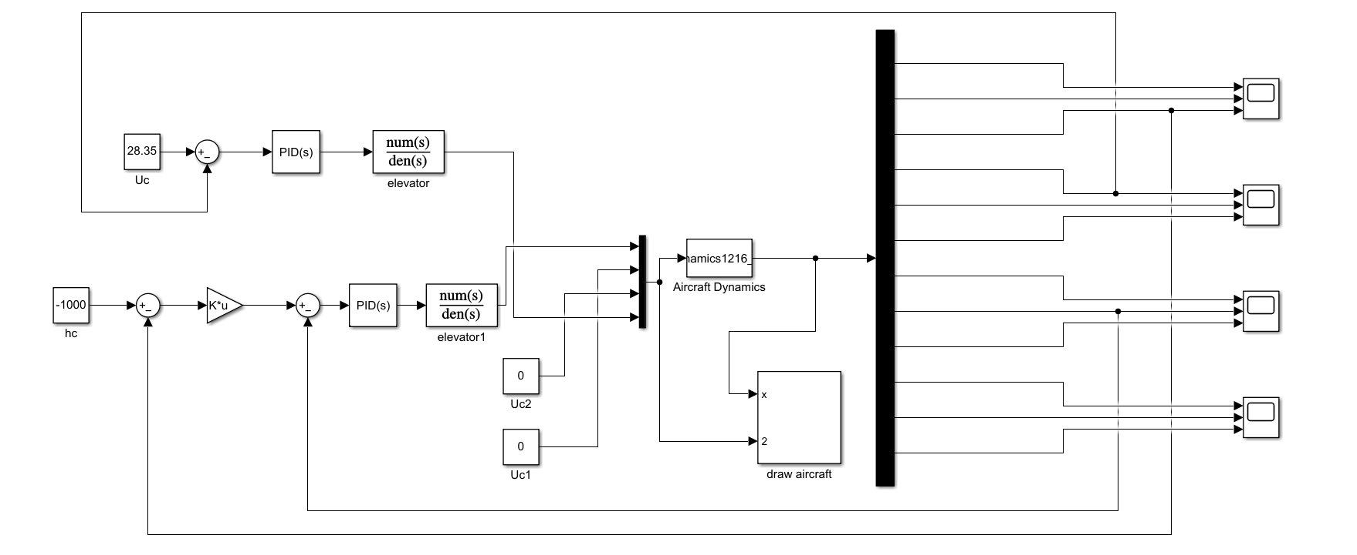
FIXED-WING sUAS DEVELOPMENT
ALTITUDE HOLD CONTROL:

Slide 8
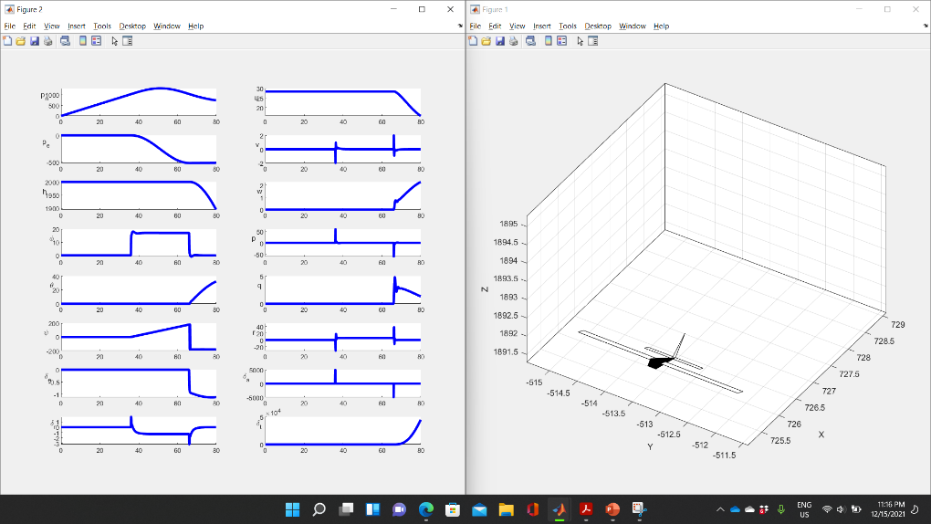
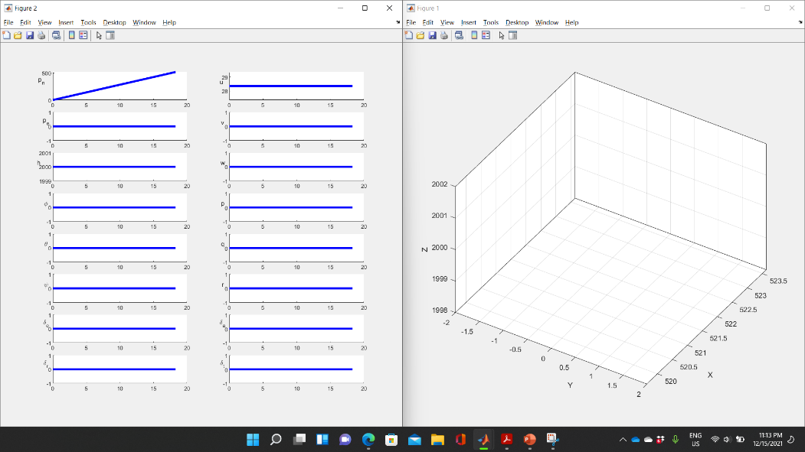
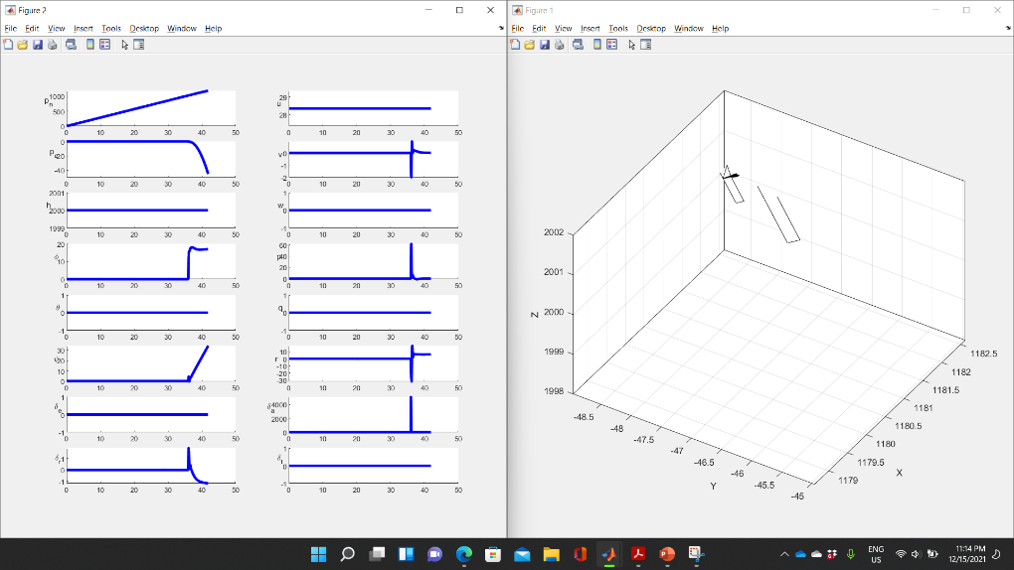
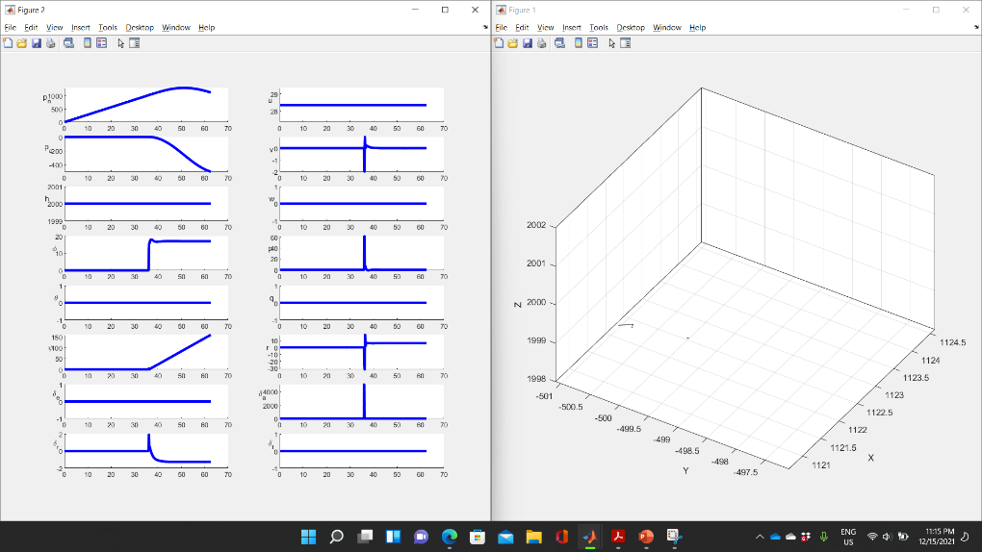
FIXED-WING sUAS DEVELOPMENT
SIMULATION & MANEUVERS:

Slide 9
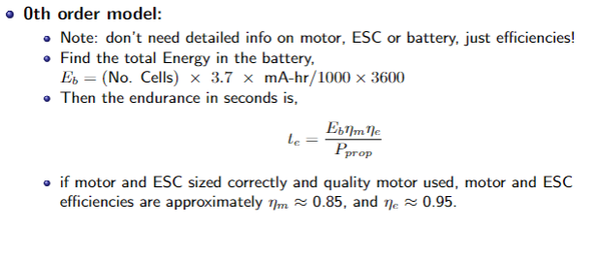
QUADROTOR DEVELOPMENT
RANGE
Max. Range = 34 kms
Forward Speed for range = 9.5 m/s
Formula Used:
Max. Range (min Ptot) speed= V/Vh
ENDURANCE
Max. Endurance = 68.1 minutes
Forward Speed for Endurance = 7 m/s
Formula Used:
Approach Used: Momentum Forward Flight Theory

Slide 10
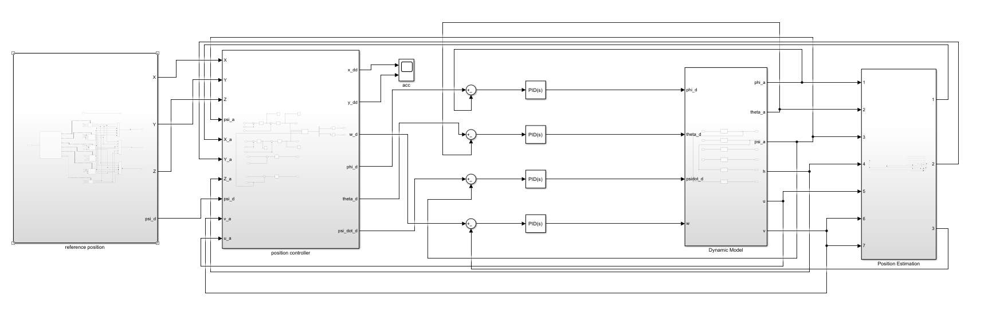
QUADROTOR DEVELOPMENT
DYNAMICS MODEL:

Slide 11
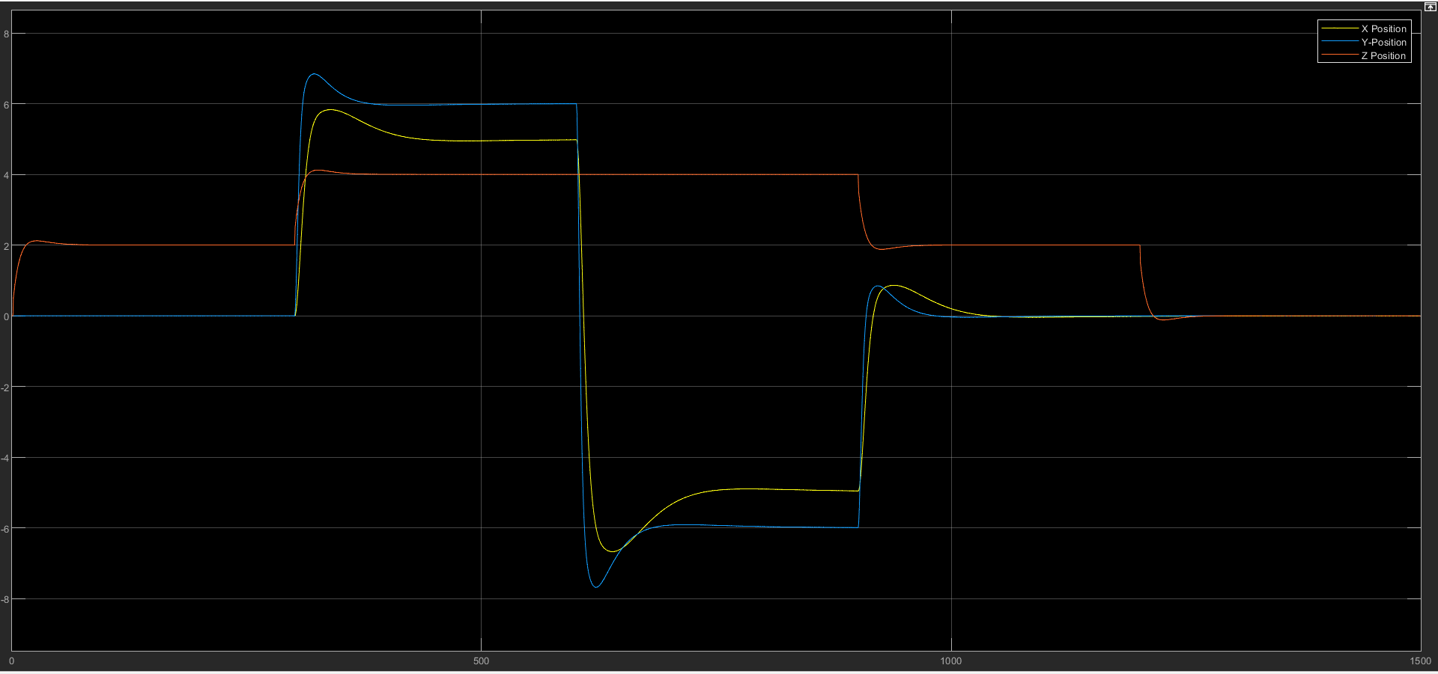
QUADROTOR DEVELOPMENT
POSITION/ORIENTATION CONTROL:

Slide 12
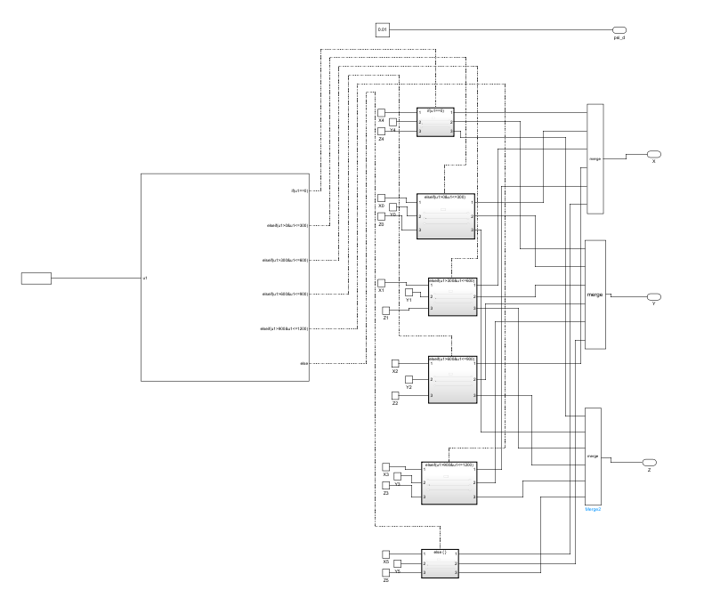
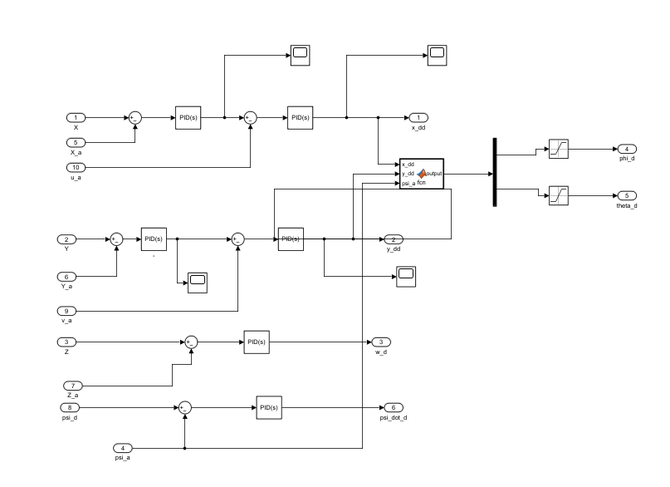
QUADROTOR DEVELOPMENT
REFERENCE POSITION AND POSITION CONTROLLER

Slide 13
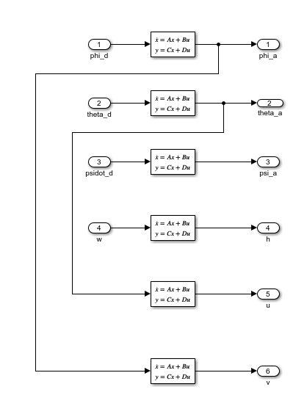
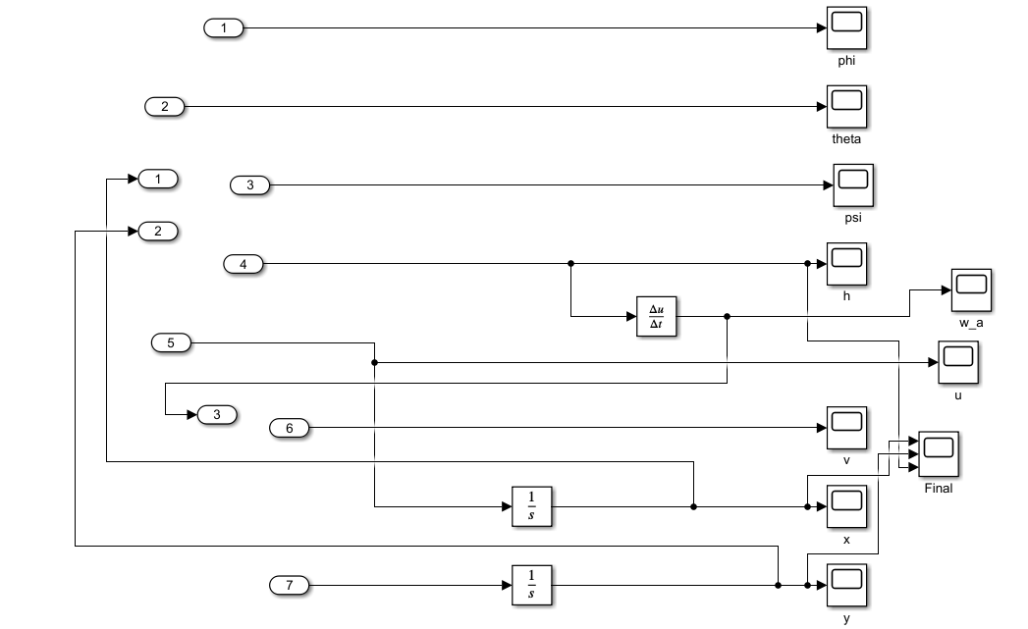
QUADROTOR DEVELOPMENT
DYNAMICS MODEL AND POSITION ESTIMATION

Slide 14
CONCLUSIONS & LESSONS LEARNED
CONCLUSIONS
180 ° coordinated turn with a radius of approx. 257m. within 30.2 secs. (Fixed Wing)
The simulation for Fixed Wing was performed for 500 secs.
The multi-rotor simulation was performed for 1500 secs.
Both Fixed Wing and multi-rotor were able to complete all the maneuvers successfully.
LESSONS LEARNED
Difference between Linearized and Non-Linearized control models
Using theoretical approaches like Momentum Flight Theory to understand performance of UAS
Deviation in data because of inconsistencies
Importance of PID Control (simple, yet effective)

Slide 15
THANK YOU!
QUESTIONS?

